Slide 1






Slide 2
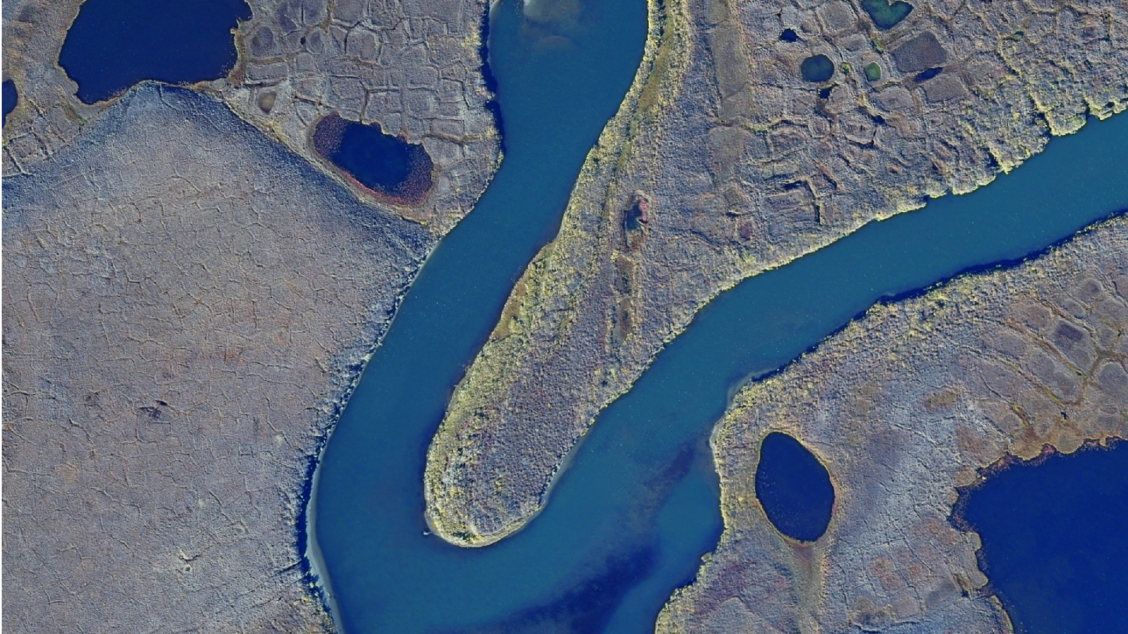
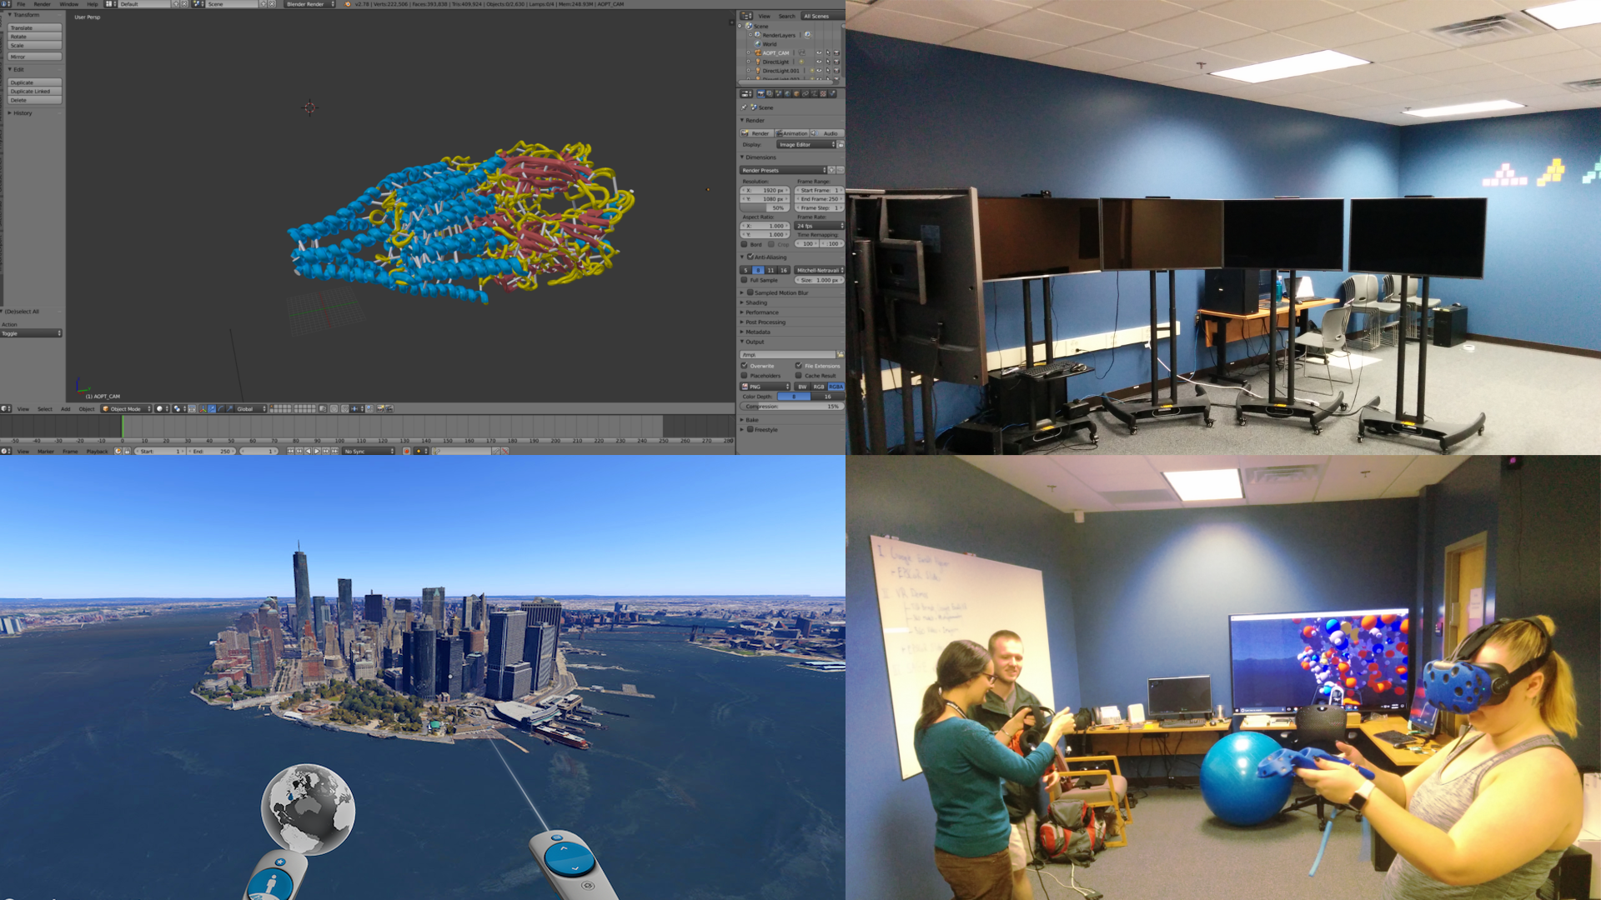
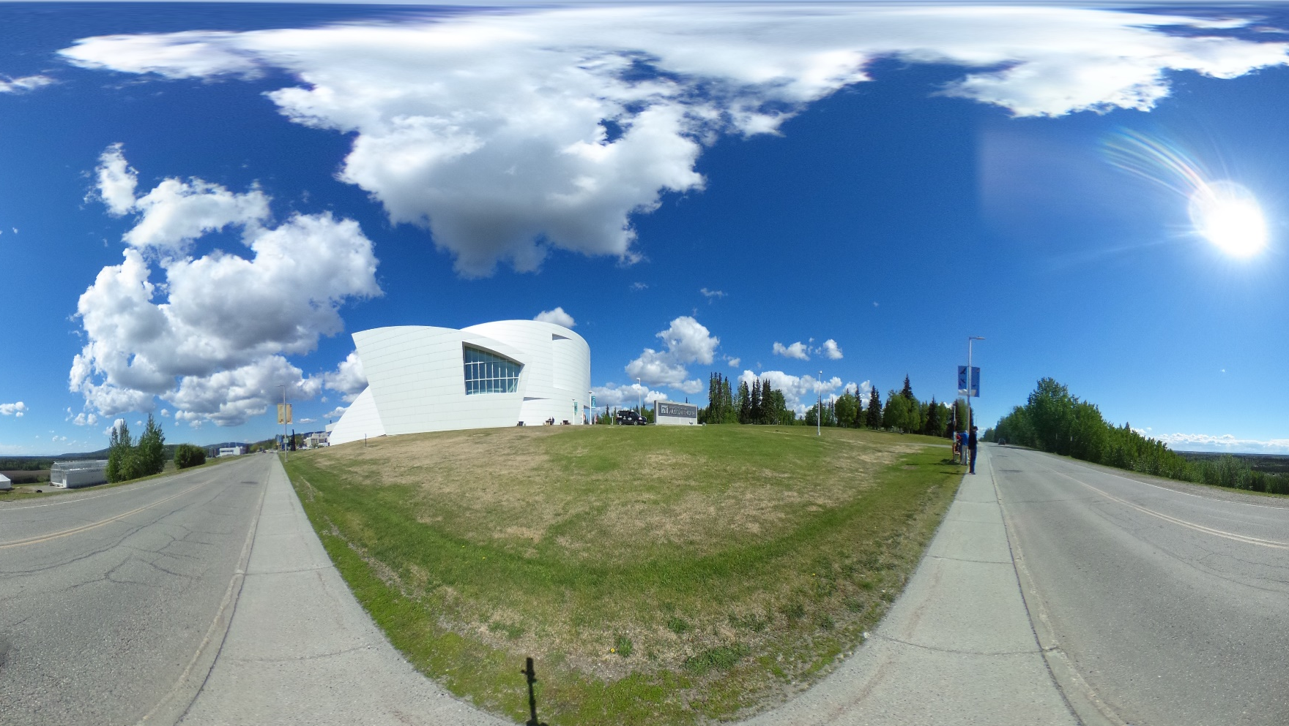
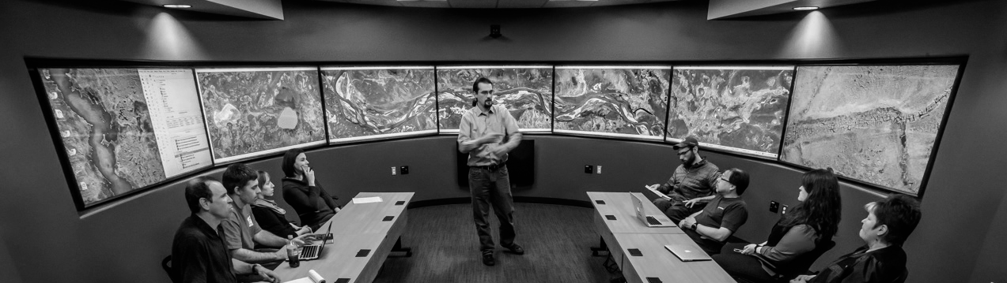

DTN
360° Video
and
Imagery
DEVELOPMENT SPACE
AND
VIRTUAL REALITY
GEO-SPATIAL
USE CASES
SAGE2
BASICS

Slide 3
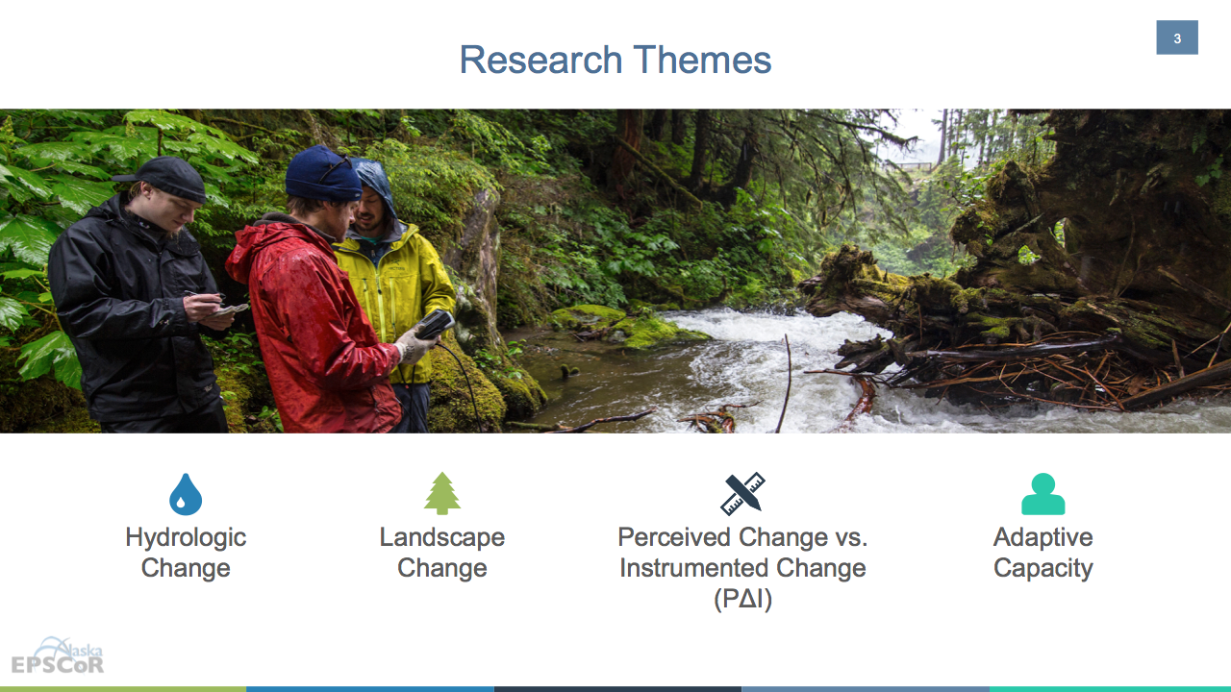
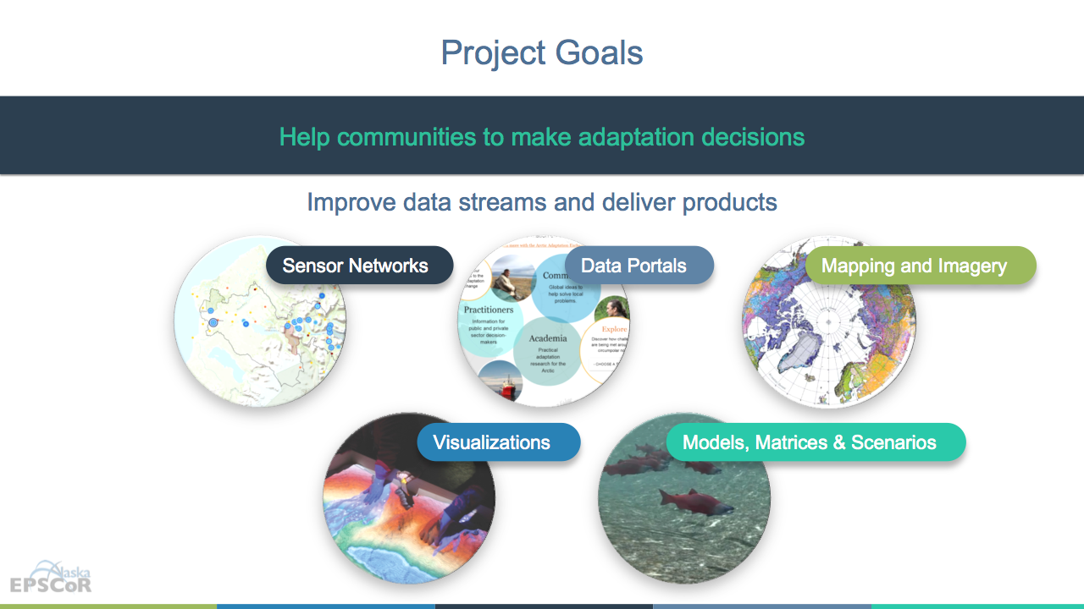


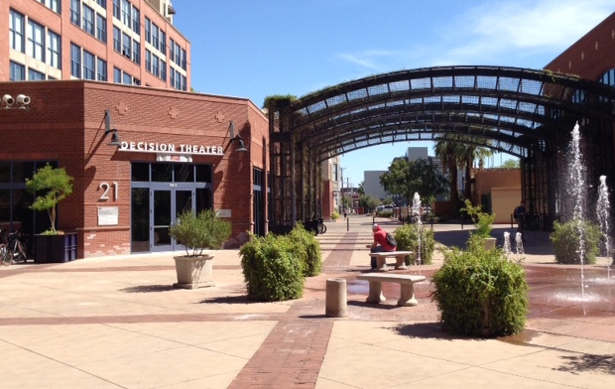
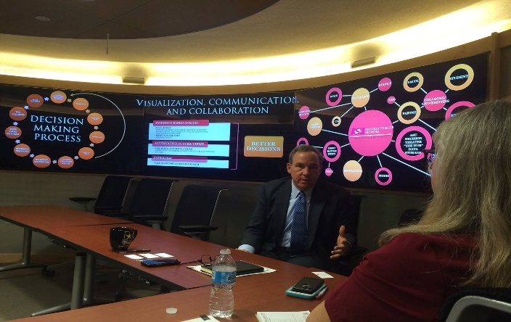



Decision Theater Network
Data to Decisions
People
desirability
Alaska ACE: Adapting to Changing Environments
The mission of Decision Theater North is to provide a cutting-edge, immersive, visual environment to facilitate dialogue and decision-making by agencies, industry, communities and academia.
Data
reliability
Solutions
sustainability
Decision Theater North is a gathering place for people to discuss issues that span the boundaries of location, time, and discipline.
ASU Decision Theater
Arizona State University
Tempe, AZ
ASU Decision Theater
McCain Institute
Washington, D.C.

Slide 5
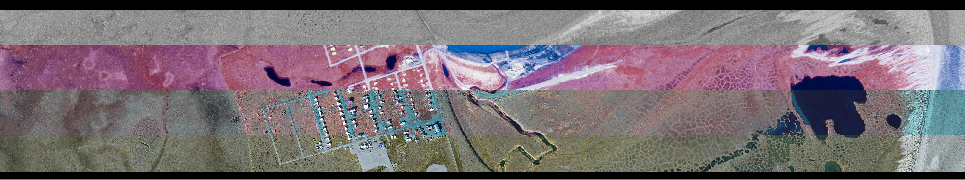
<Home Button> | QGSI ArcGIS Geo-Spatial and Satellite Imagery |  |  |  | <Text about Northern Tests Case?> | Logos?

Slide 6
Menu | Key Points | Delta Junction Mapathon Images | Mapathons | North Slope Mapathon Images? | Other info and stats | Logos?

Slide 7
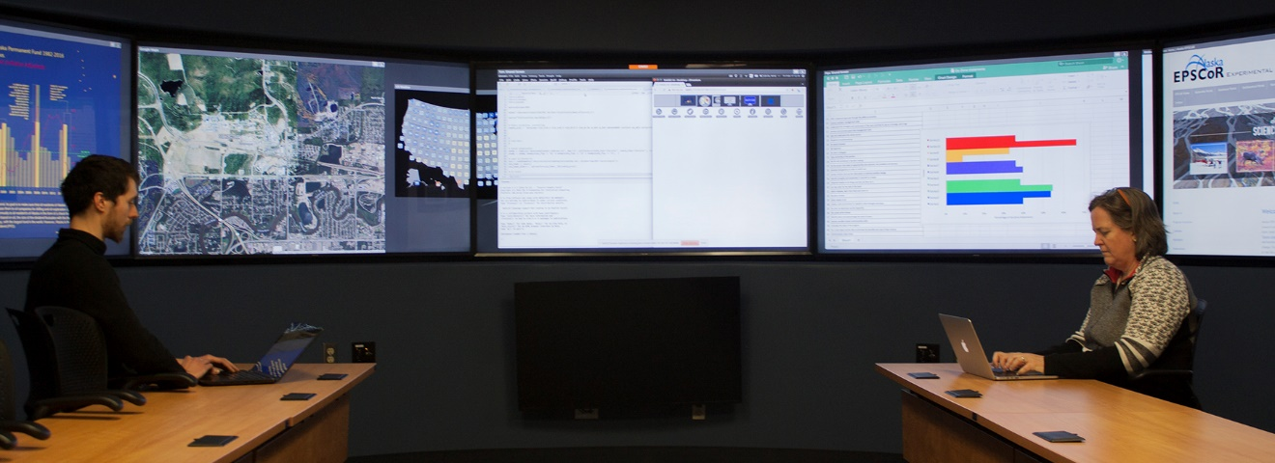
SAGE2
Enable groups to work in front of large shared displays
University of Illinois
at Chicago’s Electronic
Visualization Laboratory
(EVL)
Remote DTN screen control from own device
Note-taking and on-screen drawing
Visualize large volumes of information in ultra-high resolution
Scalable
Remote web-browser control
Amplified
Data intensive co-located and remote collaboration
University of Hawai’i at
Manoa’s Laboratory for
Advanced Visualization and
Applications (LAVA)
Screen and file sharing
Group
Powerful and flexible cloud-based and web technologies for collaborative scenarios
Envronment
Wireless access

Slide 8


Slide 10
 | 3D Modeling and photogrammetry | VR applications video tour | Dev Space and VR things | First Friday art/VT!/Outreach? | 360 Video and Imagery

Slide 12





